Slide 1


B.M.S COLLEGE OF ENGINEERING BENGALURU
Autonomous Institute, Affiliated to VTU
A PRESENTATION ON :
Predicting Employees’ Performance Using Data Mining Techniques
PRESENTED BY :
P PREM SAI (1BM19CS109)
Internal Guide :
VIKRANTH B.M
ASSISTANT PROFESSER

Slide 2

CONTENTS
1. Introduction
2. Literature survey
3. Methodology/techniques or algorithm used
4. Description of tool selected
5. Detailed description of modules implemented
6. New learning's from the topic
7. References and Annexures

Slide 3
INTRODUCTION :
Human Resources Management (HRM) has become one of the essential interests of managers and decision makers in almost all types of businesses to adopt plans for correctly discovering highly qualified employees. Accordingly, managements become interested about the performance of these employees. Especially to ensure the appropriate person allocated to the convenient job at the right time. From here, the interest of data mining (DM) role has been growing that its objective is the discovery of knowledge from huge amounts of data. In this paper, DM techniques were utilized to build a classification model for predicting employees’ performance using a real dataset collected from the Ministry of Egyptian Civil Aviation (MOCA) through a questionnaire prepared and distributed for 145 employees. Three main DM techniques were used for building the classification model and identifying the most effective factors that positively affect the performance. The techniques are the Decision Tree (DT), Naïve Bayes, and Support Vector Machine (SVM). To get a highly accurate model, several experiments were executed based on the previous techniques that are implemented in WEKA tool for enabling decision makers and human resources professionals to predict and enhance the performance of their employees.

Slide 4
LITREATURE SURVEY :
Many researches have used DM classification techniques for generating rules and predicting certain attitudes in various fields of science . therefore, evaluation and prediction of employee’s performance efficiency are considered as a critical issue for detecting the whole number of variables and criteria related to the predictive model efficiency of the employees’ performance that have been reviewed. In this section, a comprehensive study is presented on employee’s performance prediction model and criteria that this model measure based on the following literature study:
Kirimi JM, Motur CA (2016) concentrates on collecting employees’ data of a public management development institute in Kenya using the user interface, generating a decision tree based on the historical data of employees, identifying the relationship between the DT accuracy and employees’ attributes. Moreover, they concentrated on the possibility of constructing two or more prediction techniques for predicting the employees’ performance and choosing the best suitable one for this organization .

Slide 5
Desouki M. S., Al-Daher J (2015) presented a study for applying DM techniques such as DT, Key Nearest Neighbors (KNN), and SVM to the HRM field through analyzing the Performance Appraisal (PA) results, which supported by a multi-discipline academic research organization in order to enhance the appraisal method and assess the compatibility of practical implementation with the objectives of PA process. To achieve that, various DM tasks have been utilized such as clustering, classification, and prediction. This study concluded that DM tasks can be hopeful and important in dealing with the activities of human resource like enhancing the methods of performance’s evaluation.
V.Kalaivani, M.Elamparithi (2014) applied DT techniques in order to predict the employees’ performance; this is the objective of their research. DT is one of the most popular classification technique that creates both a tree and rules set; building the model of based a given data set. There are various DT algorithms as ID3, C4.5, CART, Bagging, Random Forest, Rotation forest, and CHAID. In this study, C4.5, Bagging and Rotation Forest algorithms are utilized, which are implemented in WEKA toolkit. Experiments were performed based on the collected data from an institution.

Slide 6
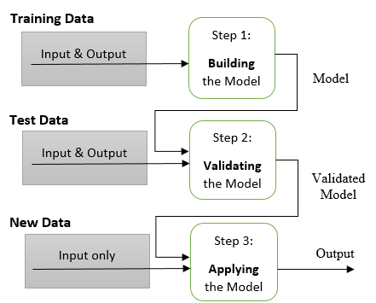
METHODOLOGY/TECHNIQUES OR ALGORITHM USED :
The proposed methodology was adopted for the objective, which is building the classification model studying certain factors that may affect and predict the employees’ performance. For achieving this objective, it is necessary to exist a generic guide to develop a DM project lifecycle containing certain steps that includes:
1. Problem Definition and Objective Structuring
2. Data Collection and Understanding
3. Data Preparing and Preprocessing
4. Modeling and Experiments
5. Testing and Evaluating.

Slide 7
ALGORITHMS
Decision Tree Algorithm:
Decision Tree algorithm belongs to the family of supervised learning algorithms. Unlike other supervised learning algorithms, the decision tree algorithm can be used for solving regression and classification problems too.
The goal of using a Decision Tree is to create a training model that can use to predict the class or value of the target variable by learning simple decision rules inferred from prior data(training data).
In Decision Trees, for predicting a class label for a record we start from the root of the tree. We compare the values of the root attribute with the record’s attribute. On the basis of comparison, we follow the branch corresponding to that value and jump to the next node.

Slide 8
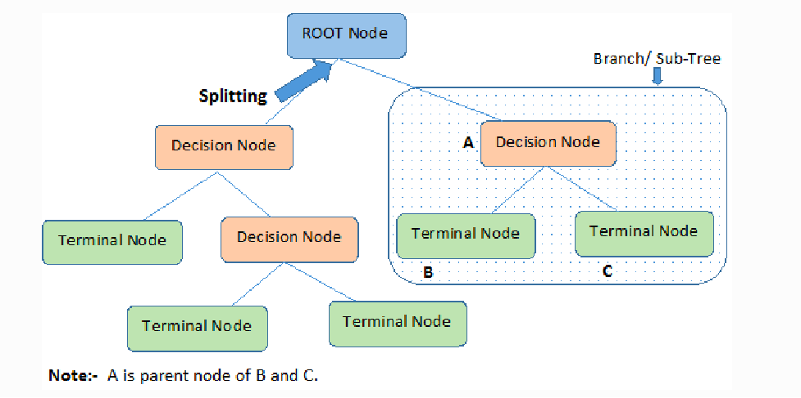
Decision trees classify the examples by sorting them down the tree from the root to some leaf/terminal node, with the leaf/terminal node providing the classification of the example.
Each node in the tree acts as a test case for some attribute, and each edge descending from the node corresponds to the possible answers to the test case. This process is recursive in nature and is repeated for every subtree rooted at the new node.

Slide 9
C4.5 Algorithm :
C4.5 is an algorithm used to generate a decision tree developed by Ross Quinlan.^{[1]} C4.5 is an extension of Quinlan's earlier ID3 algorithm.
C4.5 builds decision trees from a set of training data in the same way as ID3, using the concept of information entropy. The training data is a set S=s1,s2,……… of already classified samples. Each sample s(i) consists of a p-dimensional vector (x(1,i),x(2,i),……….,x(p,i)) where the x(i) represent attribute values or features of the sample, as well as the class in which s(i) falls.
At each node of the tree, C4.5 chooses the attribute of the data that most effectively splits its set of samples into subsets enriched in one class or the other. The splitting criterion is the normalized information gain (difference in entropy). The attribute with the highest normalized information gain is chosen to make the decision. The C4.5 algorithm then recurses on the partitioned sublists.

Slide 10
This algorithm has a few base cases :
1.All the samples in the list belong to the same class. When this happens, it simply creates a leaf node for the decision tree saying to choose that class.
2.None of the features provide any information gain. In this case, C4.5 creates a decision node higher up the tree using the expected value of the class.
3.Instance of previously-unseen class encountered. Again, C4.5 creates a decision node higher up the tree using the expected value.
In pseudocode, the general algorithm for building decision trees is:[
1.Check for the above base cases.
2.For each attribute a, find the normalized information gain ratio from splitting on a.
3.Let a_best be the attribute with the highest normalized information gain.
4.Create a decision node that splits on a_best.
5.Recurse on the sublists obtained by splitting on a_best, and add those nodes as children of node.

Slide 11
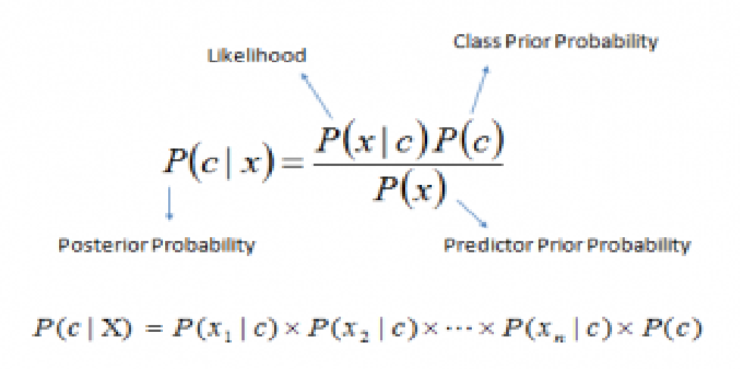
Naive Bayes algorithm :
It is a classification technique based on Bayes’ Theorem with an assumption of independence among predictors. In simple terms, a Naive Bayes classifier assumes that the presence of a particular feature in a class is unrelated to the presence of any other feature.
Naive Bayes model is easy to build and particularly useful for very large data sets. Along with simplicity, Naive Bayes is known to outperform even highly sophisticated classification methods.
Bayes theorem provides a way of calculating posterior probability P(c|x) from P(c), P(x) and P(x|c). Look at the equation below:
Where ,
P(c|x) is the posterior probability of class (c, target)
given predictor (x, attributes).
P(c) is the prior probability of class.
P(x|c) is the likelihood which is the probability of predictor
given class.
P(x) is the prior probability of predictor.

Slide 12
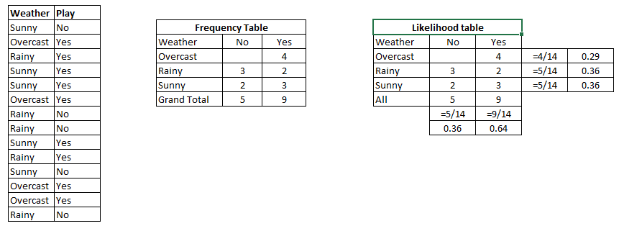
Naive Bayes algorithm working :
A training data set of weather and corresponding target variable ‘Play’ (suggesting possibilities of playing). Now, we need to classify whether players will play or not based on weather condition. Let’s follow the below steps to perform it.
Step 1: Convert the data set into a frequency table
Step 2: Create Likelihood table by finding the probabilities like Overcast probability = 0.29 and probability of playing is 0.64.
Step 3: Now, use Naive Bayesian equation to calculate the posterior probability for each class. The class with the highest posterior probability is the outcome of prediction.

Slide 13
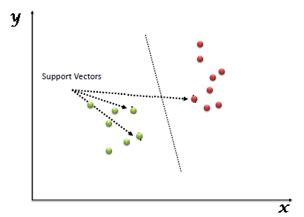
Support Vector Machine Algorithm
“Support Vector Machine” (SVM) is a supervised machine learning algorithm which can be used for both classification or regression challenges. However, it is mostly used in classification problems. In the SVM algorithm, we plot each data item as a point in n-dimensional space (where n is number of features you have) with the value of each feature being the value of a particular coordinate. Then, we perform classification by finding the hyper-plane that differentiates the two classes very well (look at the below snapshot).
Support Vectors are simply the co-ordinates of individual observation. The SVM classifier is a frontier which best segregates the two classes (hyper-plane/ line).

Slide 14
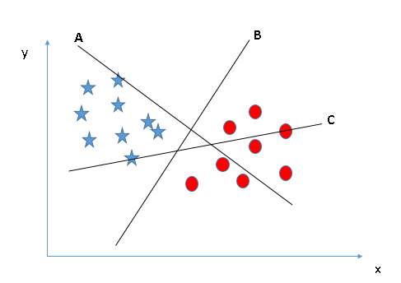
Scenario-1 :
Identify the right hyper-plane : Here, we have three hyper-planes (A, B and C). Now, identify the right hyper-plane to classify star and circle.
You need to remember a thumb rule to identify the right hyper-plane: “Select the hyper-plane which segregates the two classes better”. In this scenario, hyper-plane “B” has excellently performed this job.

Slide 15
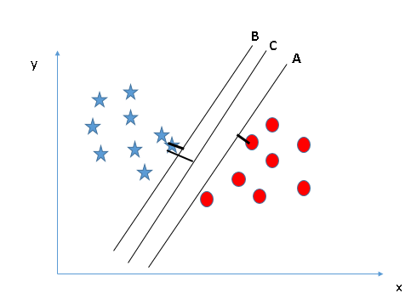
Scenario-2 :
Identify the right hyper-plane : Here, we have three hyper-planes (A, B and C) and all are segregating the classes well. Here, maximizing the distances between nearest data point (either class) and hyper-plane will help us to decide the right hyper-plane. This distance is called as Margin.
Above, you can see that the margin for hyper-plane C is high as compared to both A and B. Hence, we name the right hyper-plane as C. Another lightning reason for selecting the hyper-plane with higher margin is robustness. If we select a hyper-plane having low margin then there is high chance of miss-classification.

Slide 16
DESCRIPTION OF TOOL SELECTED :
In this work, Data Mining techniques were utilized to build a classification model for predicting employees’ performance using a real dataset collected from the Ministry of Egyptian Civil Aviation (MOCA) through a questionnaire prepared and distributed for 145 employees. Three main DM techniques were used for building the classification model and identifying the most effective factors that positively affect the performance. The techniques are the Decision Tree (DT), Naïve Bayes, and Support Vector Machine (SVM).
Data mining is defined as a process used to extract usable data from a larger set of any raw data. It implies analysing data patterns in large batches of data using one or more software. Data mining has applications in multiple fields, like science and research. As an application of data mining, businesses can learn more about their customers and develop more effective strategies related to various business functions and in turn leverage resources in a more optimal and insightful manner. For segmenting the data and evaluating the probability of future events, data mining uses sophisticated mathematical algorithms. Data mining is also known as Knowledge Discovery in Data (KDD).

Slide 17
A decision tree is a structure that includes a root node, branches, and leaf nodes. Each internal node denotes a test on an attribute, each branch denotes the outcome of a test, and each leaf node holds a class label. The topmost node in the tree is the root node.
The Naive Bayesian classifier is based on Bayes’ theorem with the independence assumptions between predictors. A Naive Bayesian model is easy to build, with no complicated iterative parameter estimation which makes it particularly useful for very large datasets. Despite its simplicity, the Naive Bayesian classifier often does surprisingly well and is widely used because it often outperforms more sophisticated classification methods.
SVM or Support Vector Machine is a linear model for classification and regression problems. It can solve linear and non-linear problems and work well for many practical problems. The idea of SVM is simple: The algorithm creates a line or a hyperplane which separates the data into classes.

Slide 18
DETAILED DESCRIPTION OF MODULES IMPLEMENTED :
The stage of Classification process comes after the data has been prepared and preprocessed. Three classification techniques were used, which they are SVM, DT, and Naïve Bayes classifier. These classification techniques are used and applied on the dataset for building the employees’ performance prediction model to get the most proper DM technique and the most effective variables that may affect and predict the employees’ performance as discussed at table.
These variables consist of (A) Professional information such as: job title, rank, No. of experience years, No. of the service years at MOCA, No. of companies that worked for previously, salary, ask about working in comfortable conditions, ask about the existence of comfort and satisfaction with the salary, job, work conditions, and ask about getting trainings, (B) Personal information such as: age, gender, marital status, (C) Educational information such as: grade, degree, general specification, and university type. All these variables used to predict the target class (performance of MOCA’s employees) to be Excellent, Very Good, or Good.

Slide 19
Variable Symbol | Variable |  | Description
X1 | JobTitle |  | Employee’s Job Title
X2 | Rank |  | Employee’s Rank or Level
X3 | #ExpYears |  | No. of Working Experience Years
X4 | ServicePeriod |  | Service Period at MOCA (in Years)
X5 | #PrevCo. |  | No. of Previous Companies the employee worked for
X6 | SalRange |  | Range of Employee’s Salary
X7 | ComfWorkCond. |  | Working in Comfortable conditions (in employee’s perspective). Answer with (Yes - No)
X8 | SatSalary |  | Existing Satisfaction for Salary (in employee’s perspective). Answer with (Yes - No)
X9 | ProfTrain. |  | Existing trainings for the job (in employee’s perspective). Answer with (Yes - No)
X10 | SatJob |  | Existing Satisfaction for the job (in employee’s Perspective). Answer with (Yes - No)
X11 | Age |  | Employee’s Age
X12 | Gender |  | Employee’s Gender
X13 | MarStatus |  | Employee’s Marital Status
X14 | EduDegree |  | Employee’s Education Degree
X15 | GenSpecial. |  | General Specialization
X16 | UniType |  | Type of the University
X17 | Grade |  | Employee’s Graduation Grade
Performance |  | Employee’s Performance either as informed or predicted. This is the target class

Slide 20
First Experiment (E1): Using the whole variables of the dataset that may affect the performance (17 variables) :
In the first Experiment (E1), the whole variables of the dataset were considered and tested to measure the prediction accuracy of the three applied classification techniques. Table 2 shows the accuracy percentages of predicting the performance for each of these techniques.
No. | Technique | Prediction Accuracy
1 | C4.5 (J48) | 77.93 %
2 | Naïve Bayes | 71.03 %
3 | SVM | 81.38 %
TABLE 2: ACCURACY PERCENTAGES FOR PREDICTION ALGORITHMS IN E1
The SVM technique is the highest through using the whole variables of the dataset with accuracy percentage 81.38%. In addition, the E1 results indicated that all these variables have some sort of effectiveness on the employees’ performance. The X9 variable is the most effective one on the performance. Other variables that participated in the decision tree generated from the C4.5 (J48) were X3, X2, X10, X14, and others had positively affected the performance.

Slide 21
Second Experiment (E2): Using the important variables resulting from the use of Feature selection algorithms (10 variables)
The feature selection algorithms were used to get the best feature subset for each algorithm from the whole dataset. These algorithms were CorrelationAttributeEval, GainRatioAttributeEval, and ReliefFAttributeEval algorithm.
Feature Selection Algorithm. | Produced Feature Subset | Prediction Accuracy
 |  | Technique
 |  | C4.5 (J48) | Naïve Bayes | SVM
CORRELATION-ATTRIBUTEEVAL | [X2,X6, X9,X11, X10,X3, X4,X14, X12,X7] | 79.31% | 73.10% | 84.14%
GAINRATIO-ATTRIBUTEEVAL | [X9,X2, X6,X3, X10,X11, X4,X1, X14,X7] | 79.31% | 72.41% | 82.07%
RELIEFF-ATTRIBUTEEVAL | [X3,X2, X6,X11, X4,X9, X14,X1, X10,X15] | 79.31% | 73.79% | 82.76%
TABLE 3: ACCURACY PERCENTAGES FOR PREDICTION ALGORITHMS IN E2 BASED ON USING FEATURE SELECTION ALGORITHMS

Slide 22
The C4.5 (J48) had the same accuracy percentage when the three feature selection algorithms were used even with the different produced feature subsets. The naïve bays classifier had the best prediction accuracy with percentage 73.79% when the ReliefFAttributeEval feature selection algorithm was used. The SVM algorithm had the best prediction accuracy with percentage 84.14% when the CorrelationAttributeEval feature selection algorithm was used. In addition, its accuracy percentages through using the three algorithms of the feature selection in E2 was better than the opposite one in E1.
The 10 variables of the produced feature subsets had a weight from 0 to 1 and sorted in descending order. All of them had a greatly affected the employees’ performance but the most effective factor differ from each feature selection algorithm and other based on its weight through the used algorithm.
No. | Feature Selection Algorithm | Most Effective Variable (Greatest weight)
1 | CORRELATION-ATTRIBUTEEVAL | Rank (X2)
2 | GAINRATIO-ATTRIBUTEEVAL | ProfTrain. (X9)
3 | RELIEFF-ATTRIBUTEEVAL | #ExpYears (X3)
Table 4 : The most effective variable of the feature selection algorithm

Slide 23
Third Experiment (E3): Using the most effective variables resulting from the tree generated using Decision Tree technique (5 variables)
In this experiment (E3), DT technique was used as a classification technique using its algorithm C4.5 to get the generated tree that illustrate the most effective factors on the employees’ performance and rank them with its effectiveness. The generated tree showed the five variables that had greatly affected the performance were X9, X3, X2, X14, and X10 as illustrated in figure . That experiment can be applied to determine whether the variables reduction would affect the accuracy of the classifier or not.
No. | Technique | Prediction Accuracy
1 | C4.5 (J48) | 79.31 %
2 | Naïve Bayes | 82.07 %
3 | SVM | 86.90 %
TABLE 5 : ACCURACY PERCENTAGES FOR PREDICTION ALGORITHMS IN E3 BASED ON THE FIVE EFFECTIVE VARIABLES

Slide 24
According to table 5, the results of the E3 indicated that the SVM technique had the highest prediction accuracy through using the most five effective factors with accuracy percentage 86.90 %. If the three experiments’ results of E1, E2, and E3 were reviewed, The SVM technique would have the highest prediction accuracy at all experiments. Moreover, the prediction accuracy percentage of the SVM technique increased when the number of used variables had decreased at each experiment.
The results of E3 answered about the question of did the variables reduction would affect the accuracy of the classifier or not. Where, the results proved that the less of the used variables, the higher of the classifier accuracy. Therefore, it is very important to determine the variables that had the greatest effect on the performance to get the highest predication accuracy.
The generated tree indicated that all five variables had some sort of effect on employee’ performance, but the profTrain. (X9) variable had the greatest positive effect on the employees’ performance and it was the starting node at the tree as shown in figure below. Where those employees that underwent professional training had a better performance than ones who did not as previously illustrated. If the three experiments’ results of E1, E2 were reviewed, and E3, the results would prove that the X9 variable was common in all experiments. Other variables that participated in the generated tree were Rank, #ExpYears, EduDegree, and SatJob variable.

Slide 25
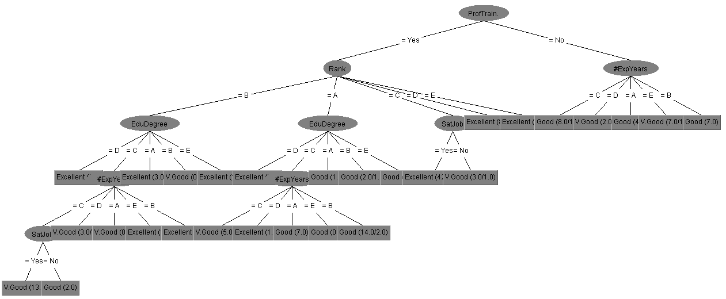
The decision tree generated from using C4.5 algorithm for E3 to predict employees’ performance:

Slide 26
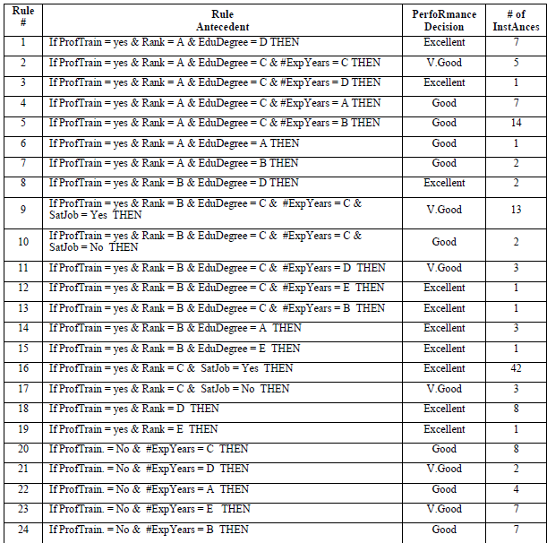
TABLE 6: CLASSIFICATION RULES GENERATED BY C4.5 ALGORITHM IN E3 FOR PREDICTING EMPLOYEES’ PERFORMANCE

Slide 27
NEW LEARNINGS FROM THE TOPIC :
This paper has concentrated on the capability of building a predictive model for employees’ performance of MOCA using classification techniques through studying and testing the factors that might positively affect the performance of the MOCA’s employees. Some of them had greatly affected the performance prediction. Proftrain. (X9) was found as the most effective factor on the performance then the #ExpYears (X3). The SVM technique was found as the most suitable classifier for building the predictive model, where it had the greatest prediction accuracy through all the three experiments that had executed with the highest percentage 86.90%. WEKA toolkit was used through executing the experiments.
For decision makers and HRM department, this model, or an enhanced one, can be utilized in predicting the performance of the potential talents that will be promoted, predicting the performance of the recently applicant employees where various actions can be taken for avoiding any risk related to hiring employees with a low performance, or so on.
This topic made us to learn how Data Mining techniques such as Decision Tree (DT), Naïve Bayes, and Support Vector Machine (SVM) are used to find the performance of employess by using different variables of the employee.
Finally, when the suitable predictive model is generated, an application could be developed to be used by the decision makers and HR’s Officials based on the generated rules for predicting the performance of employees.

Slide 28
REFERENCES AND ANNEXURES
1.https://www.researchgate.net/publication/347113656_A_Proposed_Model_for_Predicting_Employees%27_Performance_Using_Data_Mining_TechniquesA. Abusharekh, S.A. Stewart, N. Hashemian, S.S.R. Abidi
2. L. Sadath, (2013) “Data Mining: A Tool for Knowledge Management in Human Resource,” International Journal of Innovative Technology and Exploring Engineering, Vol. 2, Issue 6, April 2013.
3. G. K. Gupta (2006) “Introduction to Data Mining with Case Studies” ISBN-81-203-3053-6.
4. AI-Radaideh, Q. A., AI-Shawakfa, E.M., and AI-Najjar, M. I., (2006) “Mining Student Data using Decision Trees”, International Arab Conference on Information Technology(ACIT'2006), Yarmouk University, Jordan, 2006.
5. Surjeet K. Y., Brijesh B., Saurabh P., (2011) “Data Mining Applications: A comparative Study for Predicting Student's performance”, International Journal of Innovative Technology and Creative Engineering, Vol.1 No.12 (2011) 13-19.

Slide 29


